Slide 1
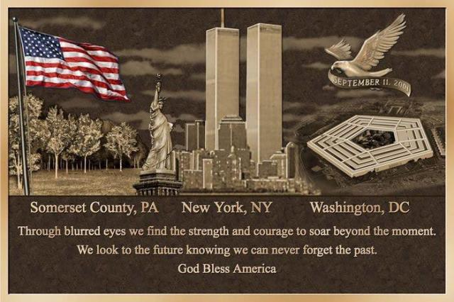
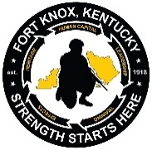
PATRIOT DAY CEREMONY
UNITED STATES ARMY
“The Army Goes Rolling Along” is the official song of the United States Army. The “Caisson Song” was originally written by Field Artillery First Lieutenant (later Brigadier General) Edmund L. Gruber, while stationed in the Philippines in 1908. The original lyrics reflect routine activities in a horse-drawn field artillery battery. The song was transformed into a march by John Philip Sousa in 1917 and renamed “The Field Artillery Song.” It was adopted in 1956 as the official song of the Army and retitled, “The Army Goes Rolling Along.” The current lyrics tell the story of the Army’s past, present, and future. The “Army Goes Rolling Along” is played at the conclusion of every U.S. Army ceremony and all Soldiers are expected to stand and sing along.
March along, sing our song,
With the Army of the free.
Count the brave, count the true,
Who have fought to victory.
We’re the Army and proud of our name!
We’re the Army and proudly proclaim:
First to fight for the right,
And to build the Nation’s might,
And THE ARMY GOES ROLLING ALONG.
Proud of all we have done,
Fighting till the battle’s won,
And THE ARMY GOES ROLLING ALONG.
Then it’s Hi! Hi! Hey!
The Army’s on its way.
Count off the cadence loud and strong!
For where’er we go,
You will always know
That THE ARMY GOES ROLLING ALONG.
Kentucky Veterans Cemetery - Central
Radcliff, Kentucky
September 11, 2023
8:15 A.M

Slide 2
SOLDIER’S CREED
I am an American Soldier.
I am a Warrior and member of a team.
I serve the people of the United States, and live the Army Values.
I will always place the mission first.
I will never accept defeat.
I will never quit.
I will never leave a fallen comrade.
I am disciplined, physically and mentally tough, trained and proficient in my warrior tasks and drills.
I always maintain my arms, my equipment and myself.
I am an expert and I am a professional.
I stand ready to deploy, engage, and destroy the enemies of the United States of America in close combat.
I am a guardian of freedom and the American way of life.
I am an American Soldier.
DUTY CALLS
I have no ambition in this world but one, and that is to be a firefighter. The position may, in the eyes of some, appear to be a lowly one; but we who know the work which the firefighter has to do believe that theirs is a noble calling. There is an adage which says that, “Nothing can be destroyed except by fire.” We strive to preserve from destruction the wealth of the world which is the product of the industry of men, necessary for the comfort of both the rich and the poor. We are defenders from fires of the art which has beautified the world, the product of the genius of men and the means of refinement of mankind. But, above all, our proudest endeavor is to save the lives of men — the work of God Himself. Under the impulse of such thoughts, the nobility of the occupation thrills us and stimulates us to deeds of daring, even at the supreme sacrifice. Such considerations may not strike the average mind, but they are sufficient to fill to the limit our ambition in life and to make us serve the general purpose of human society.
— Chief Edward F. Croker, New York City Fire Department circa 1910
POLICE OFFICER’S PRAYER
When I start my tour of duty God, wherever crime may be, as I walk the darkened streets alone, let me be close to Thee. Please give me understanding with both the young and old. Let me listen with attention until their story's told. Let me never make a judgment in a rash or callous way, but let me hold my patience, let each man have his say. Lord, if some dark and dreary night, I must give my life, Lord, with your everlasting love, protect my children and my spouse.
— Author Unknown
SEQUENCE OF EVENTS
Pre-ceremony Music 100TH Army Band
National Anthem 100TH Army Band
Invocation Chaplain (LTC) Douglas Yates
Welcome Mr. Whitney Allen
Commissioner, Kentucky
Department of Veterans Affairs
Address Major General Johnny Davis
Commanding General
USAREC and Fort Knox
Flag Folding HRC Honor Guard
Tolling of the Bell Lead Fire Inspector Jo Cruea
Amazing Grace 100TH Army Band
Moment of Silence All Guests
Wreath Laying Major General Johnny Davis
Battalion Chief Ryan Pratt
Deputy Chief Gerry LaPlace
21 Gun Salute 19TH Engineer Battalion
Taps 100TH Army Band
God Bless America 100TH Army Band
Closing Music 100TH Army Band

